Slide 1

Happifier
Online Counselling and Mental Health Screening Tool

Slide 2
Our Mission:
To build a one-stop platform connecting all sources of mental health help, while taking care of anonymity and other concerns students may have.

Slide 3
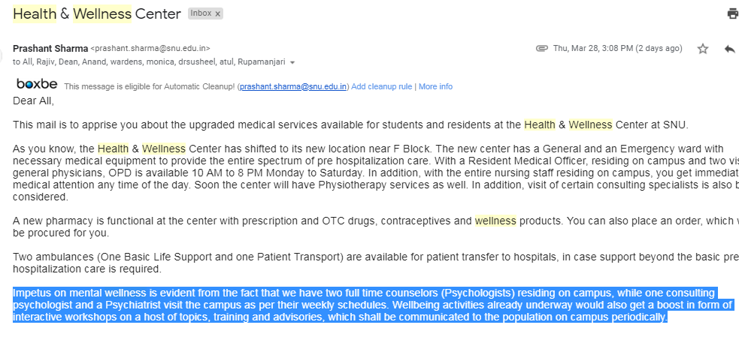
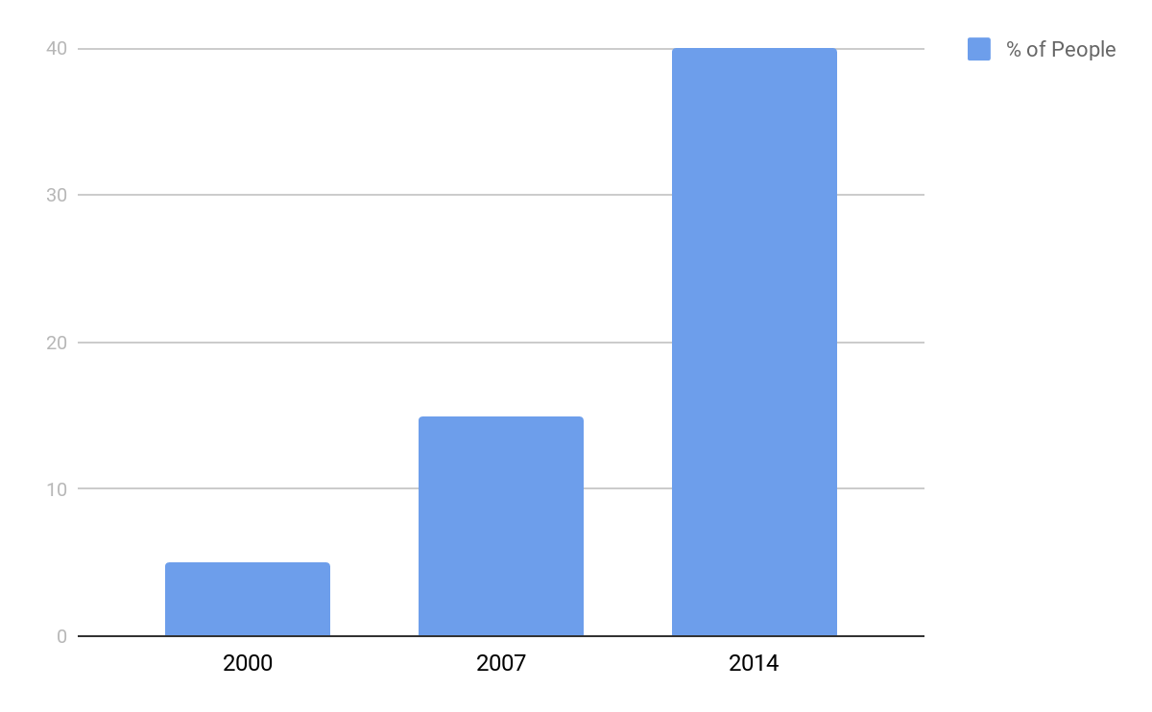
Why this Project?
Upwards trend of people suffering through mental health issues
Increasing awareness about mental health
Notes:
Percentage of people with common mental health problems receiving treatment in 2000, 2007 and 2014
Increase in awareness: this topic has been brought to forefront in recent times, and has been made mainstream due to its recent popularisation and increasing acceptance

Slide 4
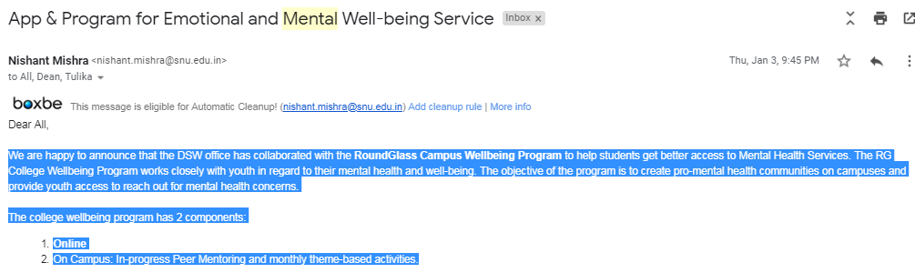
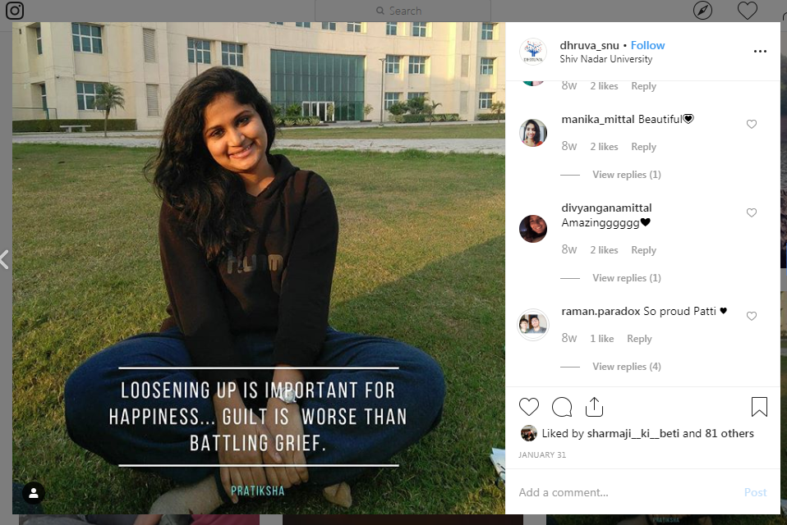
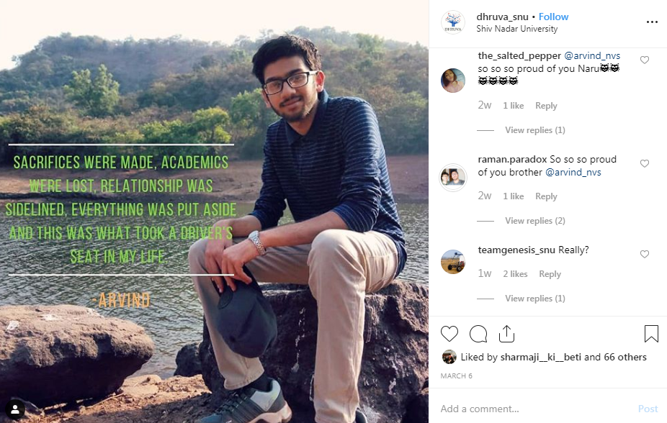
Why this Project?
Increase in attention given by college authorities to this issue
Increase in openness and sharing of experiences
Notes:
Attention given by college authorities: with increasing attention and acceptance, college authorities are now offering free of cost help to their students. Our own college now houses more campus psychologists and has collaborated with RoundGlass which provides an app for campus well being.
Increasing openness:We’ve had campus wide events where people who have suffered through depression have shared their story. more and more people are sharing their stories and experiences of their struggle, which, for example, can be seen on the instagram page of Dhruva or several other posts of pages related to SNU. Their openness is highly applauded and encourages others.
All this encouraged us to develop a product that would help students navigate their college life and help them stay mentally healthy.

Slide 5
Market Research

Slide 6

Why our Product?
A consolidated platform for mental health
Relevance to college students
Availability of direct connection to volunteers and/or trained professional
Better emotional connect
Visual appeal and ease of navigation and use
Notes:
One stop solution: it beautifully combines all features that would be helpful to a person suffering from mental health problems. It helps you to diagnose, book appointment and find support by taking a look at the journey of others, all in one platform. In future, we also plan to include self-help methods to further help students.
Relevance to college students: it provides a platform to those seeking support within the confines of a college. Students can seek support from the network of volunteers and other students. Also, students can publish their journey anonymously, and thus it lessens the stigma of ‘log kya kahenge’
Availability of direct connection: our product provides a chatbox to the user, wherein the user can directly chat with volunteer, who has a specific specialization, or with a trained professional, i.e., psychiatrist/psychologist
Emotional connect: while using any other site, the stories we read are of people we don’t know about. This platform’s feed allows us to explore the journeys of people who we see everyday and are living in the same environment as us, thus resulting in a better emotional connection.
Visual appeal and ease of navigation and use: simple ui that requires minimum number of clicks to navigate. Clean cut look. Available as an app too, thus making access and use of the product easier.

Slide 7
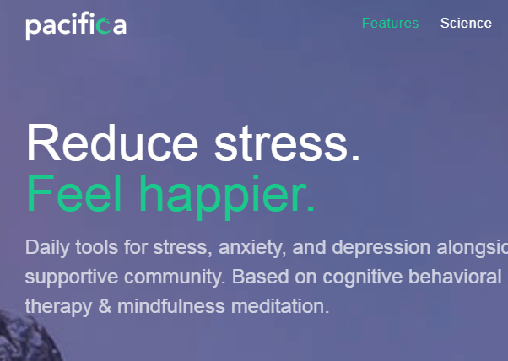
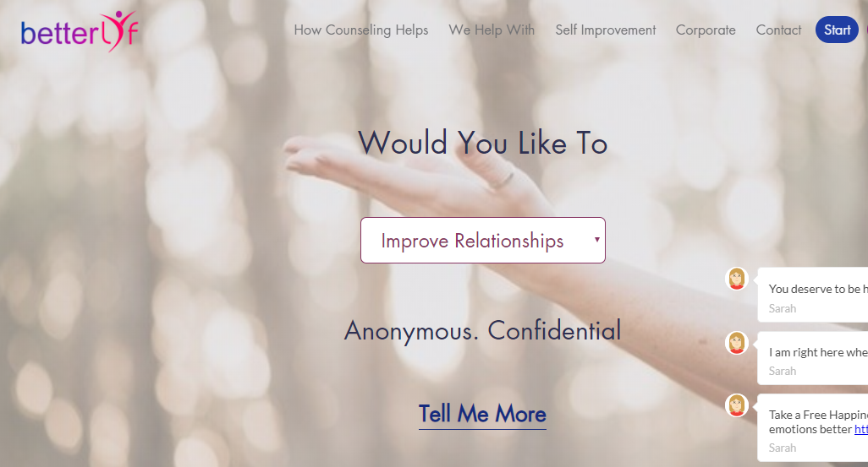
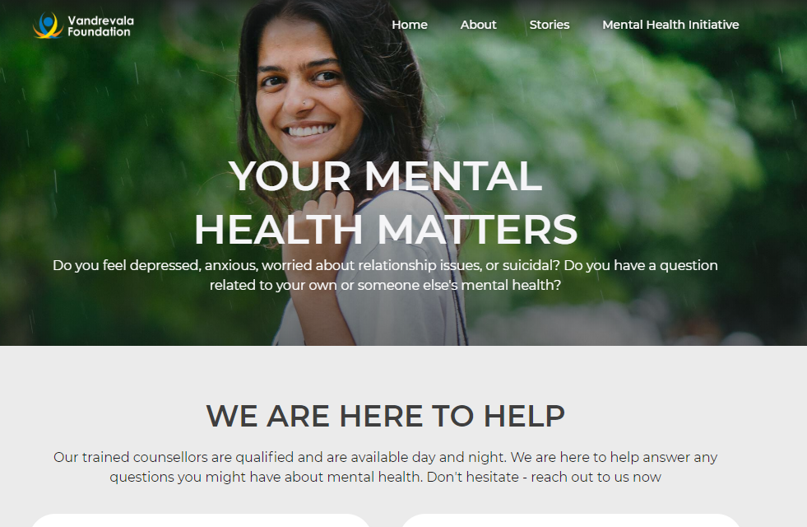
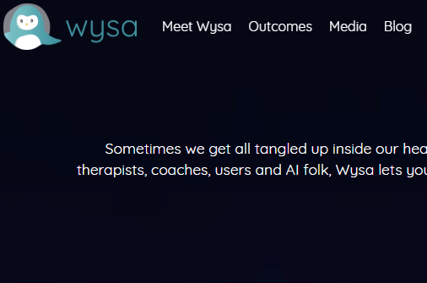
Us v/s Them
One disorder, one website: Websites like Vandrevela Foundation and BetterLyf
Free for Students: Apps like Pacifica
Notes:
One disorder, one website: these sites mostly only concentrate on stress and anxiety or counselling with events that may cause them. Our site not only talks about these, but also about other disorders related to anger, ptsd and substance abuse
One feature, one app: the apps specified revolve around only one feature- tests to self-diagnose, or chat with professionals, or self-help. Our product combines all of them in one app and thus saves space and effort
Free for students: at the moment, our business model charges no one for using our product. Eventually, we would like professionals to use this platform to advertise themselves. However, at all points this product will be free for students, unlike apps like pacifica, which requires paid subcription.

Slide 8








Tech Stack

Slide 9
FEASIBILITY STUDY

Slide 10
TECHNICAL FEASIBILITY
Is the proposed solution practical?
2. What kinds of technology will be needed?
Android, Firebase, React, Redux, Thunk are few of the platforms that will be used to create the project.
Do we possess the necessary technical expertise?
Equal division of work and technology.
We might opt for a top-down approach to break the project into several small parts, find solutions to solve them and put them together.
Will it be compatible with other systems?
Only android presently
Website to cater to all users.
Might shift to native frameworks like Flutter or React Native
3. What technical risk is there?
Bugs might go unnoticed.
Compatibility issues with different android versions.

Slide 11
ECONOMICAL FEASIBILITY
Is the project possible, given resource(i.e money)?
Yes, because it doesn't use any pay-and-use platform.
Can use it to advertise psychologists’ services.
What is the minimal cost to build up the final project?
We are using open source softwares so there is no cost of production.
What are the benefits?
Will the benefits outweigh costs?
How soon will the benefits acure?
This can be estimated once the app is in use. We would have to estimate based on the reach and frequency of the portal.

Slide 12
SCHEDULING FEASIBILITY
How long will it take all the members to gain the technical expertise needed for this project?
Every member of the group has a fair level of working knowledge of all platforms being put to use. Based on our learning curve and time devoted, the members will be able to implement on more platform as the project moves onto better versions.
Is it possible to complete the project within the deadline?
Yes, the project can be completed within the deadline as we have a time plan for all the features to be implemented in our app
What are the consequences of delay?
Since the product isn’t a deliverable promised to a certain party, the delay won’t have any major consequences. Our aim is to present a finished product with the main features at the end of the semester. The remaining features will/can be added as and when required, after due consideration over the inputs provided by the faculty/students.
3. What are the real constraints on the project deadline?
Missed schedules are bad, but inadequate solution is worst. Thus, the real constraint is the creation of a project that is an adequate solution, with minimal bugs (if any) and doing it within 3 months.

Slide 13
SCHEDULING FEASIBILITY
Sprint 1 starts
Sprint 2 starts
Sprint 3 starts
MAR 8
April 8
April 21
FEB 15
Mar 18
April 11
Sprint 1 ends
Sprint 2 ends
Sprint 3 ends

Slide 14
OPERATIONAL FEASIBILITY
If the system is developed, will it be used?
We plan to involve the present medical service in our campus i.e. Blue Circle..
The current solutions are not up to the mark and scattered, and our consolidated platform aims to solve that problem.
How do the end-users (i.e the psychologists and students) feel about the project?
We spoke to Blue Circle and students about this project and they look forward to this app being in use.
Which users may not use the app?
With a lot of stigma still attached to mental health, we are afraid a few students might not use this app.
How will the environment for the students change?
We think that a major change in the outlook towards mental health will occur. With the marketing that this product will entail, we hope to make talking about depression and anxiety more acceptable. Another benefit would be a smoother operation of Blue Circle. The current website has high latency and crashes often, making booking appointments a nightmare.
Can all stakeholders adapt to these changes?
Given how enthusiastic and supporting everyone’s about the introduction of Happifier and how easy to use it is, we’re sure that both Blue Circle and the students will adapt to the changes. Also, we as a team, will help them ease into the app, for better consumer experience.

Slide 15
COST ESTIMATION

Slide 16
FUNCTION POINT

Slide 17
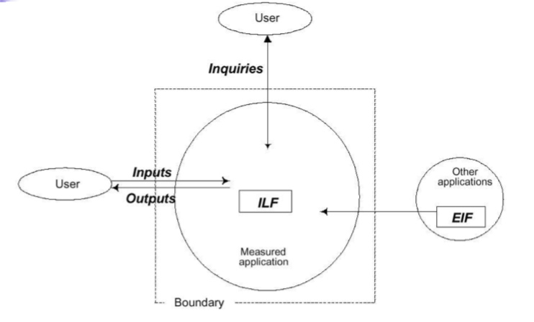
WHY FUNCTION POINT?
It is independent of programming language, technology, techniques.
They can be used for GUI systems.
It can be applied at early stage in software development.
Creation of more function points can define productivity goal as opposed to LOC.

Slide 18
The Approach
The general approach that FPA follows is:
● Count the number of inputs, outputs, inquiries, master files, and interfaces required, then calculate the Unadjusted Function Points (UFP)
● Calculate the adjusted function point (AFP) by multiplying these counts by an adjustment factor; the UFP and the product complexity adjustment.
Calculate the Source Lines of Code (SLOC) with the help of the AFP and the Language Factor (LF)

Slide 19
Calculation of Unadjusted Function Point(UFP)
The FPA measures functionality that the user requires. The specific user functionality is a measurement of the functionality delivered by the application as for user request.
The 5 function types identified are
●external input which receives information from outside the application boundary,
●external output which presents information of the information system,
●external enquiries which is special kind of an external output. An external inquiry presents information of the information system based on a uniquely identifying search criterion, without applying additional processing (such as calculations).
●internal logical files contains permanent data that is relevant to the user The information system references and maintains the data and
●external interface files also contains permanent data that is relevant to the user.
For each function identified above the function is further classified as simple, average or complex and a weight is given to each. The sum of the weights quantifies the size of information processing and is referred to as the Unadjusted Function points.

Slide 20
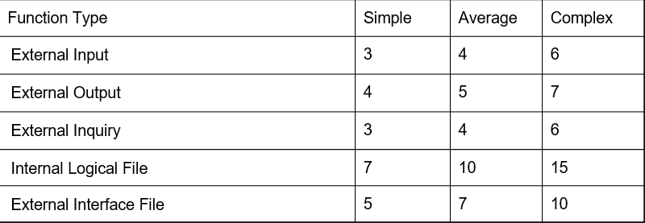
The table below shows the function types and the weighting factors for the varying complexities:

Slide 21
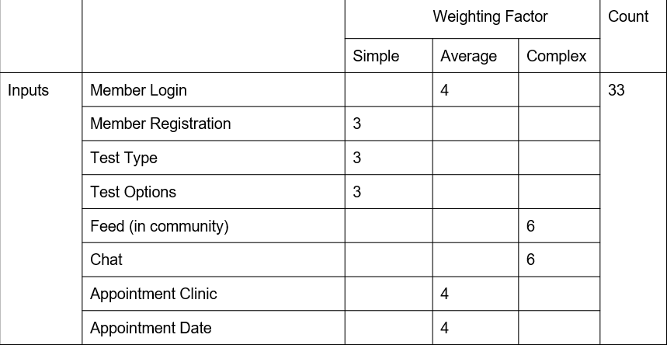
Using these definitions in previous slide, the files types in our project can be counted as follows:

Slide 22
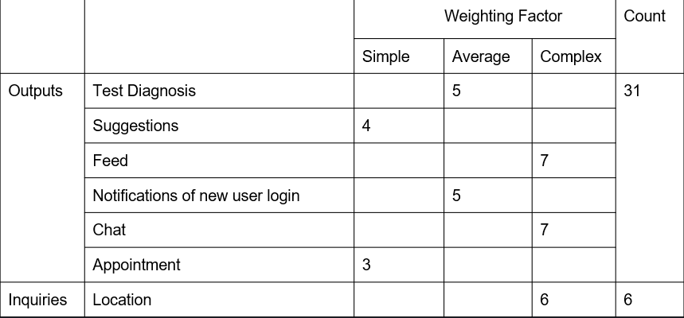

Slide 23
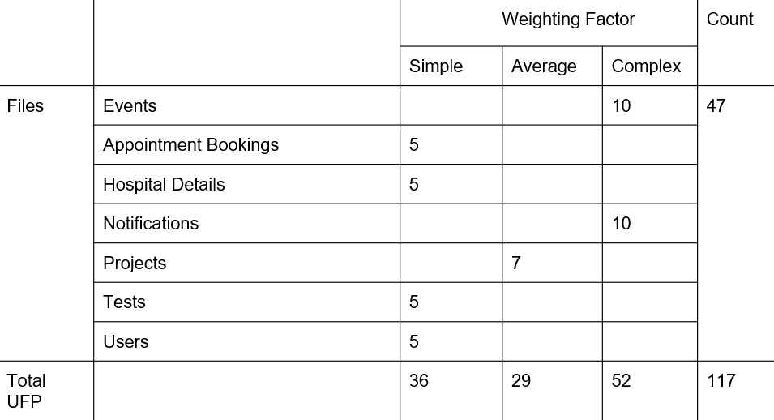

Slide 24
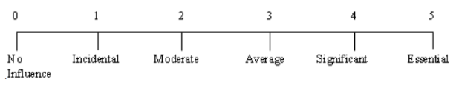
2. Calculate Adjusted Function Point
To calculate the Complexity adjustment value, several factors have to be considered, such as Backup and recovery, code design for reuse, etc. All the factors and their estimated values in this project are shown in the following table.
The adjusted function point denoted by FP is given by the formula:
FP = total UFP * (0.65 + (0.01 * Total complexity adjustment value)) or
FP = total UFP * (Complexity adjustment factor).
The 14 factors which affect the complexity and development effort are rated on a scale of 0-5 as per their degree of influence.

Slide 25
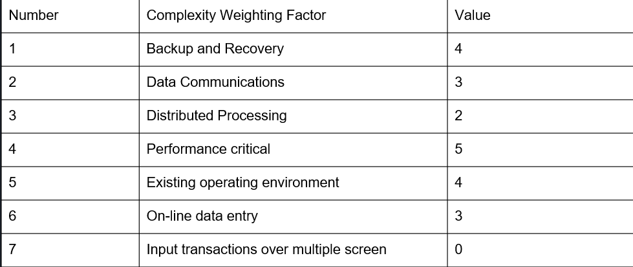
ADJUSTED FUNCTION POINTS
Number | Complexity Weighting Factor | Value
1 | Backup and Recovery | 4
2 | Data Communications | 4
3 | Distributed Processing | 2
4 | Performance critical | 4
5 | Existing operating environment | 3
6 | On-line data entry | 3
7 | Input transactions over multiple screen | 0

Slide 26
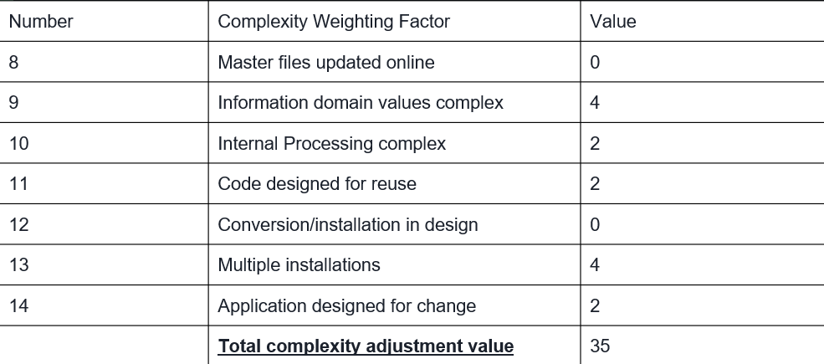
ADJUSTED FUNCTION POINTS
Number | Complexity Weighting Factor | Value
8 | Master files updated online | 2
9 | Information domain values complex | 2
10 | Internal Processing complex | 2
11 | Code designed for reuse | 4
12 | Installation Ease | 0
13 | Multiple installations | 3
14 | Application designed for change | 2
 | Total complexity adjustment value | 35

Slide 27
3. Calculate the SLOC.
Total Unadjusted Function Point = 117
Product Complexity Adjustment(PC) = 0.65+(0.01*35) = 1.00
Total Adjusted Function Points(FP) = UFP*PC = 117
Language Factor(LF) for Java assumed as = 53
Source Lines Of code (SLOC) = FP*LF = 6201 (can be verified from SONAR)
Notes:
https://www.qsm.com/resources/function-point-languages-table

Slide 28
Scrum

Slide 29
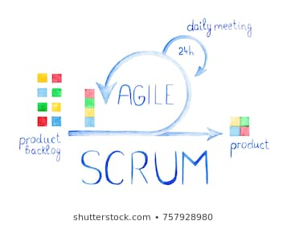
Scrum
Scrum is a framework for project management that emphasizes teamwork, accountability and iterative progress.
The three pillars of Scrum are transparency, inspection and adaptation.
Scrum roles include product owner, Scrum master and Scrum development team.

Slide 30
Scrum Product Backlog
Login
As an unauthorised user, I want to create a new account.
As an unauthorised user, I want to login.
As an authorised user, I want to logout.
Feed
As an authorised user, I want to add entries to my journal.
As an authorised user, I want to view entries of people in my circle.
Questionnaire
As an authorised user, I want to be able to take a quiz and get a score.
As an authorised user, I want to be able to add the score in the database.
As an authorised user, I want to get a diagnosis based on the score.
Notes:
https://www.scrum-institute.org/The_Scrum_Product_Backlog.php

Slide 31
Scrum Product Backlog
Chatbox
As an authorised user, I want to be able to find available volunteers with relevant tags.
As an authorised user, I want to be able to chat with said volunteer.
As an authorised volunteer, I want to be able to chat with the user.
Notification
As an authorised user, I want to get notifications when someone adds entries.
As an authorised user, I want to get notifications when a new user joins the portal.
Recommendations
As an authorised user, I want to get recommendations that will help me cope with my disorder.
As an authorised user, I want to be redirected to the activities recommended on the internet.

Slide 32
Scrum Product Backlog
Locating psychologists near us
As an authorised user, I want to locate available psychologists/psychiatrists near me to book an appointment.
As an authorised user, I want to see their locations on Google Maps.
Booking an appointment
As an authorised user, I want to be able to book an appointment for a particular time slot.

Slide 33
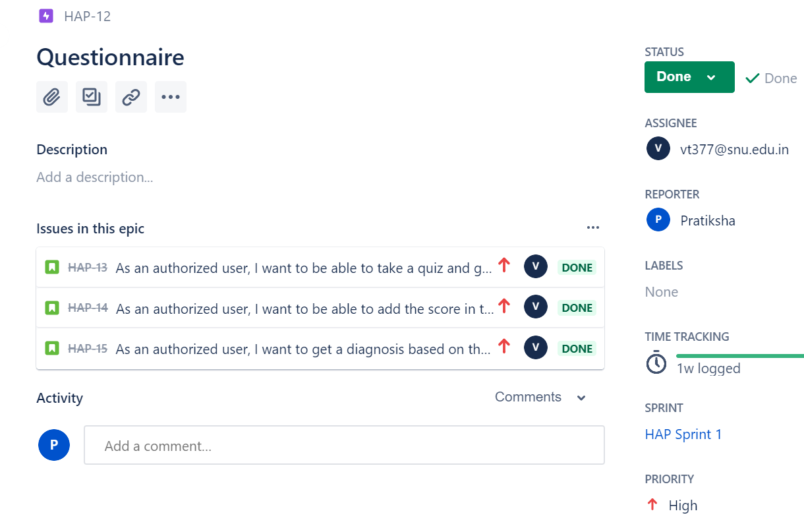
JIRA

Slide 34
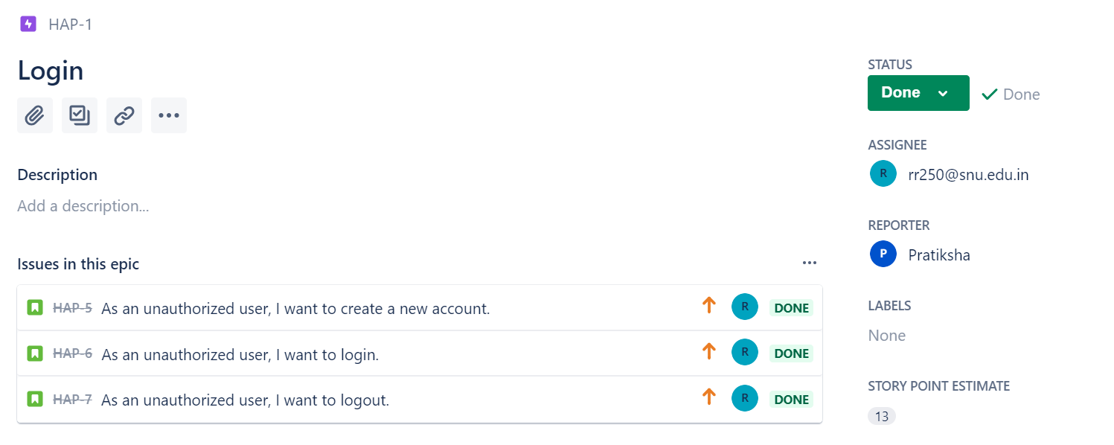
JIRA

Slide 35
Timeline

Slide 36
Sprints Timeline
Sprint 1 starts
Sprint 2 starts
Sprint 3 starts
MAR 8
April 8
April 21
FEB 15
Mar 18
April 11
Sprint 1 ends
Sprint 2 ends
Sprint 3 ends

Slide 37
Sprint 1

Slide 38
Scrum Planning Meeting
There are three user stories in this sprint.
Story points are estimated based on two factors:
Risk
Complexity
Fibonacci scale is used for story points.(0,1,1,2,3,5,8..)
User Stories and their Story Points.
Notes:
Explain user stories and story points

Slide 39
Scrum Backlog
User Story
Login Module
Story Point: 13
High Risk
Low Complexity
Acceptance Criteria
Given user details are already present in the database when user tries to login then he is directed to home page.
Given user details are not present in the database when user tries to login then error shown.
Given user details are already present in the database when user tries to login with incorrect password then there will be an error.

Slide 40
Scrum Backlog
User Story
Feed Module
Story Point: 8
Medium Risk
High Complexity
Acceptance Criteria
Given user has logged in when user adds a new story then his story is displayed in the feed.
Given user has logged in when user is at home screen then he can view other people’s stories.

Slide 41
Scrum Backlog
User Story
Questionnaire
Story Point: 21
High Risk (Incorrect diagnosis)
Low Complexity
Acceptance Criteria
Given user has logged in when user takes a test of a particular mental disorder then he is able to get a score.
Given user has logged in when user takes a test of a particular mental disorder then he is provided with a diagnosis.

Slide 42
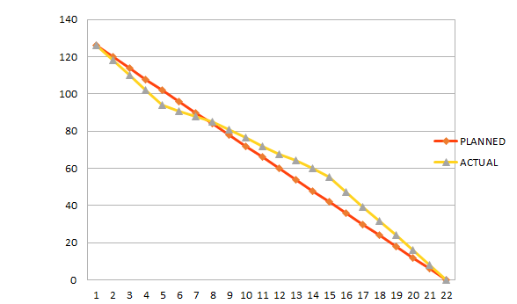
Scrum Meetings
Burndown Chart
Notes:
Progress on a Scrum project can be tracked by means of a release burndown chart.
A burn down chart is a graphical representation of work left to do versus time.
The ScrumMaster should update the release burndown chart at the end of each sprint. The horizontal axis of the sprint burndown chart shows the days; the vertical axis shows the amount of work in terms of hours remaining at the start of each sprint.
This sprint duration includes our midsem break; hence the negative deviation from the plan.

Slide 43
Sprint 2
Notes:
Sprint 2 is the sprint we are still working on. It will end on 8 April as mentioned previously. Therefore some of the user stories mentioned here are still incomplete.

Slide 44
Scrum Meeting
There are three user stories in this sprint.
Story points are estimated based on two factors:
Risk
Complexity
Fibonacci scale is used for story points.(0,1,1,2,3,5,8..)
User Stories and their Story Points.
Notes:
We have three user stories and story points criteria is similar to what was done in sprint 1

Slide 45
Scrum Backlog
User Story
Chatbox
Story Point: 34
Medium Risk
High Complexity
Acceptance Criteria
Given volunteer details are already present in the database when user tries to search by tags then he is able to find them.
Given user has logged in when user tries to connect with a volunteer then user is able to chat with them.
Given volunteer has logged in when volunteer shows himself available to chat then he is able to chat with a user.
Notes:
Chatbox risk: security breach
There will be a list of volunteers and their field of expertise in particular mental disorder.

Slide 46
Scrum Backlog
User Story
2. Notifications
Story Point: 5
Low Risk
Low Complexity
Acceptance Criteria
Given user is registered in Happifier when a new journal entry is added then he is notified.
Given user is registered in Happifier when a new user joins the portal then he is notified.
Notes:
Chatbox risk: security breach

Slide 47
Scrum Backlog
User Story
3. Recommendations
Story Point: 5
Low Risk
Medium Complexity
Acceptance Criteria
Given user has logged in when a user takes a test then he is recommended activities that will help with his disorder.
Given user has logged in when an activity is recommended then the user is redirected to the relevant resources on the internet.
Notes:
Suppose a user takes the test and his score indicates that he doesnt need a professional help as of now and he can benefit from some home therapies like doodle therapy and meditation that he can perform on his own and also he is able to directly go to relevant resources on the internet related to that therapy(for example: the uses of the therapy or the directions to perform it).

Slide 48
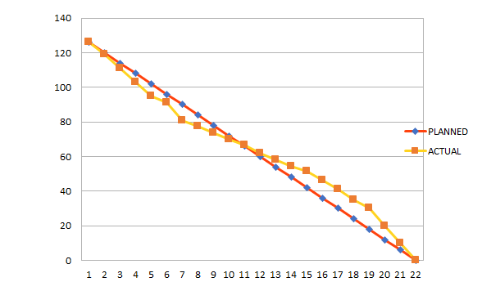
Scrum Meetings
Burndown Chart

Slide 49
Sprint 3
Notes:
Sprint 2 is the sprint we are still working on. It will end on 8 April as mentioned previously. Therefore some of the user stories mentioned here are still incomplete.

Slide 50
Scrum Meeting
There are two user stories in this sprint.
Story points are estimated based on two factors:
Risk
Complexity
Fibonacci scale is used for story points.(0,1,1,2,3,5,8..)
User Stories and their Story Points.
Notes:
We have three user stories and story points criteria is similar to what was done in sprint 1

Slide 51
Scrum Backlog
User Story
Locating psychologists near us
Story Point: 55
Medium Risk
Very High Complexity
Acceptance Criteria
Given user is logged in, when he opens the map option in the portal then he is able to locate available psychologists/psychiatrists near him.
Notes:
Chatbox risk: security breach
There will be a list of volunteers and their field of expertise in particular mental disorder.

Slide 52
Scrum Backlog
User Story
2. Booking an Appointment.
Story Point: 8
Low Risk
Low Complexity
Acceptance Criteria
Given user has logged in, when he tries to book an appointment then he is able to do it in by choosing his own preferred date.
Notes:
Chatbox risk: security breach

Slide 53
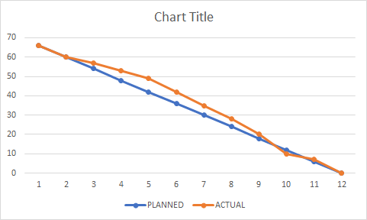
Scrum Meetings
Burndown Chart

Slide 54
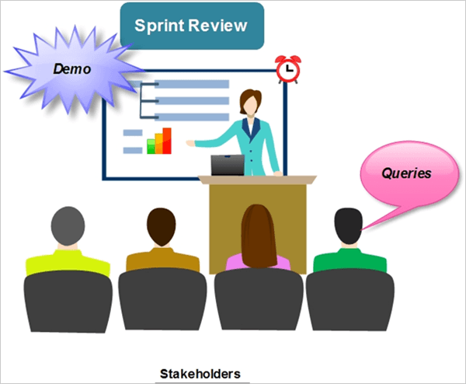
Sprint Review Meeting
What was accomplished
Informal
Entire Team Participated
Lagged behind schedule at times, were ahead of schedules at times
There was overall peace and harmony despite conflict of ideas

Slide 55
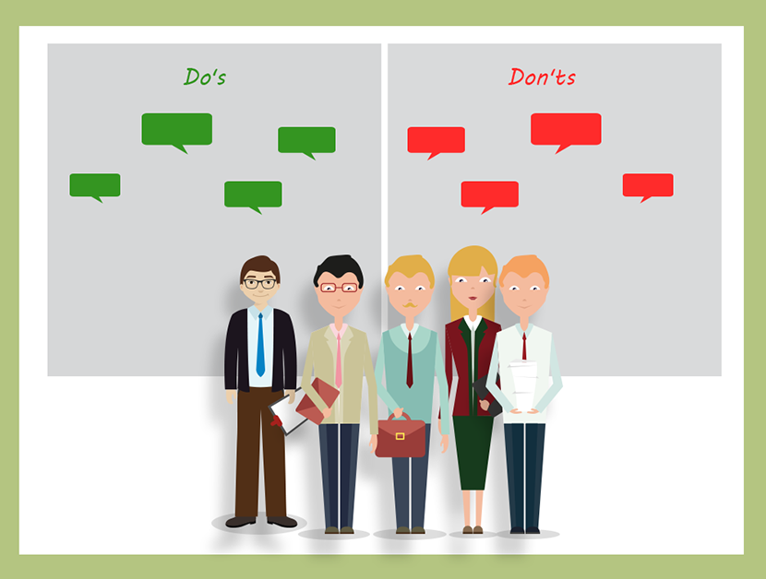
Sprint Retrospective Meeting
What went well?
The team was very motivated for the most times
What did not go well?
We took more time than what was assigned for most sprints
Meetings did not start on time
Improvements
Discouraged late comers - the person who comes late pays for everyone’s coffee

Slide 56
Daily STANDUP MEETING

Slide 57

Daily Stand up Meeting
The daily Scrum meeting is a short everyday meeting, ideally during start of the working day.
Questions:
What was accomplished since the last daily Scrum meeting?
What is going to be accomplished until the next Scrum meeting?
Notes:
The daily Scrum meeting is a short everyday meeting, ideally during start of the working day. Each team member who works towards the completion of a given sprint needs to participate. During this meeting, each team member should briefly provide the answers of the following three questions:
What has he/she accomplished since the last daily Scrum meeting?
What is he/she is going to accomplish until the next Scrum meeting?
What are the impediments that prevent him/her from accomplishing his/her tasks?
All team members should attend and they should stand during the meeting. The daily Scrum meeting should ideally not last more than 15 minutes. On the other no issues or concerns raised during the meeting are allowed to be ignored due to the lack of time. Issues or concerns ought to be recorded by the Scrum Master and needs to be specifically handled after the meeting.

Slide 58
TESTING

Slide 59

Code Testing

Slide 60
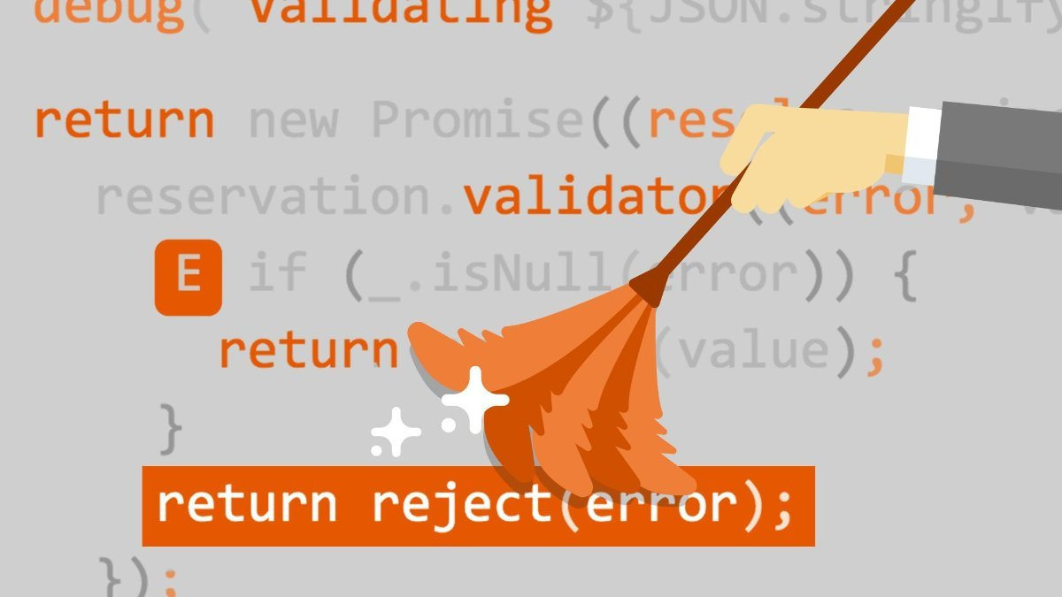
CodeTesting
Testing that is carried out on code development, code inspection, unit testing
Consists of following testing:
Dynamic Testing - Statement coverage, Branch coverage, Path coverage
Checking for Complexity of Code using techniques like Cyclomatic Complexity
Static Testing - Code Inspection, Code Walkthrough, Code Review, Code Audit

Slide 61
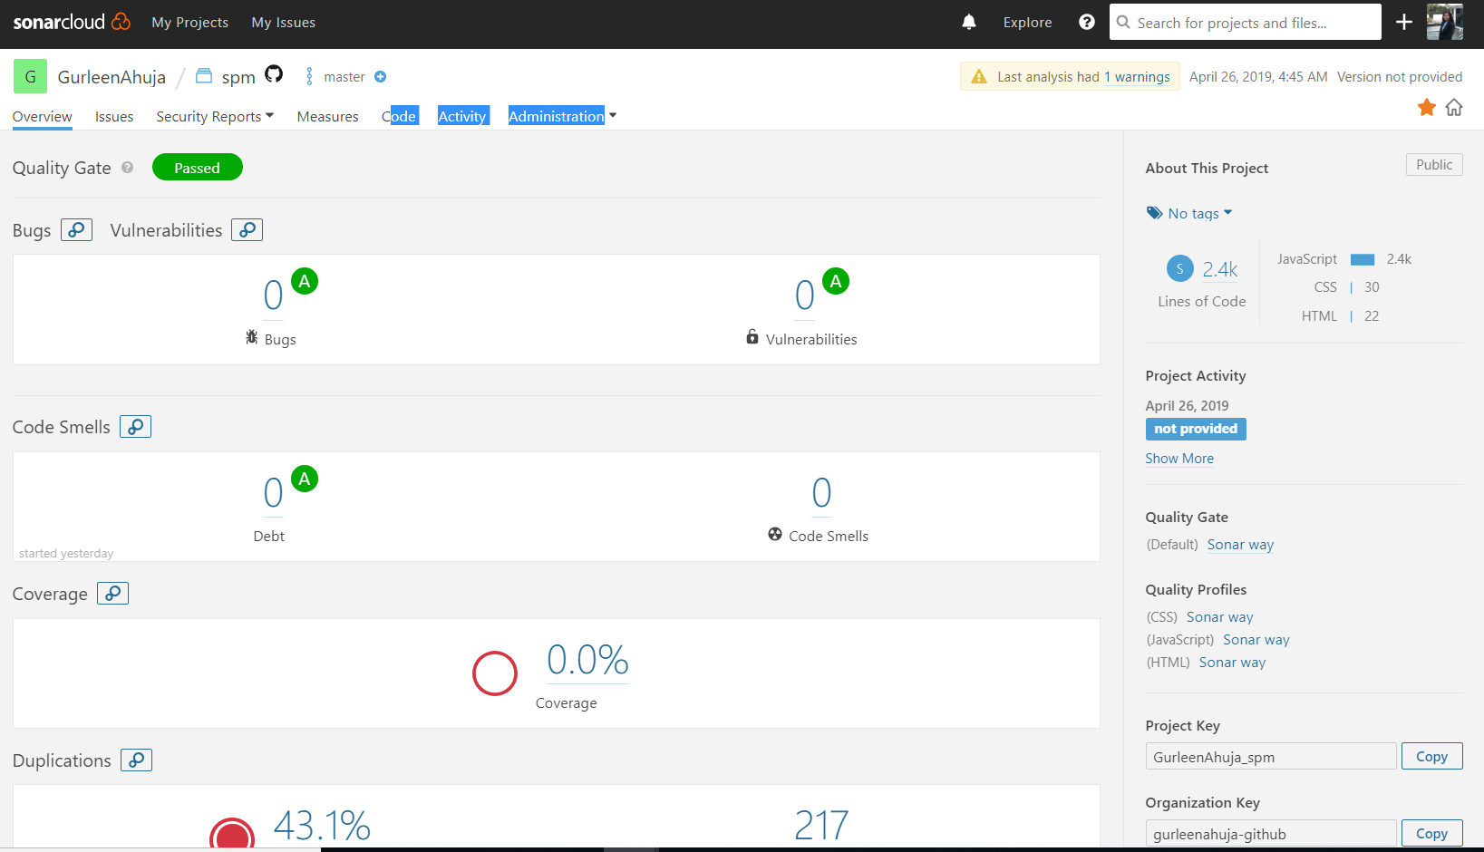
Sonarcloud - WebApp

Slide 62
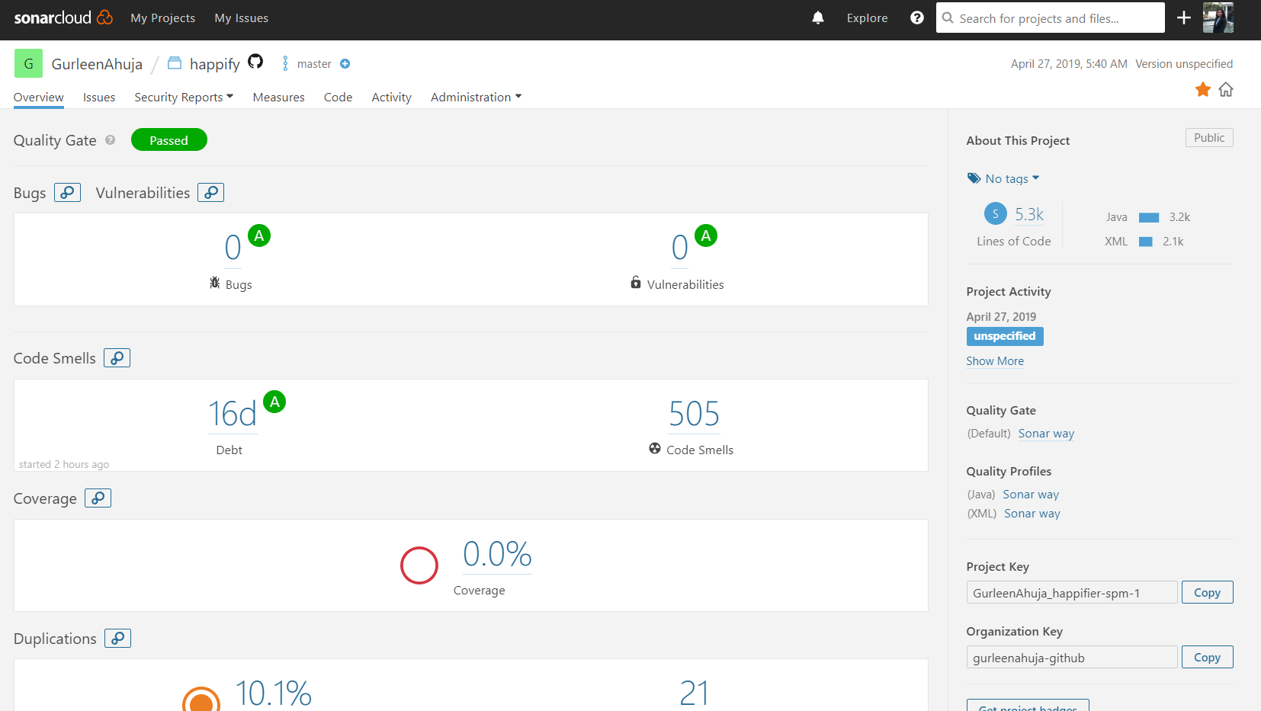
Sonarcloud- Android App

Slide 63

Advantages of Code Testing
Make the process Agile
Quality of Code
Find bugs early
Facilitates changes and simplifies integration
Reduce the cost

Slide 64

TESTING:
Unit Testing
-What is Unit Testing?
-When is it performed?
-Who performs it?

Slide 65
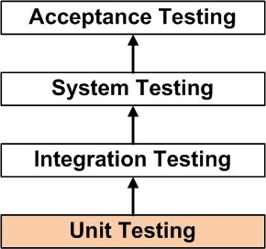
UNIT TESTING
What is Unit Testing?- Unit Testing is a level of software testing where individual units/ components of a software are tested.
When is it performed?- Unit Testing is the first level of software testing and is performed prior to Integration Testing.
Who performs it? -It is normally performed by software developers themselves or by independent software testers.

Slide 66
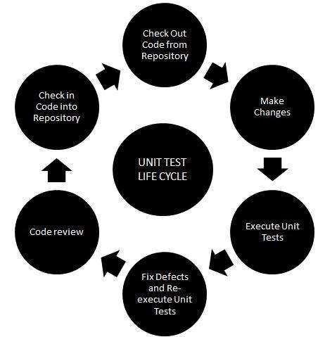
You Can't Be Agile without Automated Unit Testing
Produces working code faster
Fewer bugs
Increases the chances of a new feature working correctly upon first delivery
Pinpoint precisely the location of a problem

Slide 67
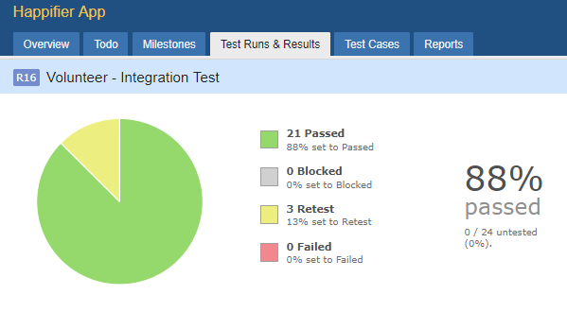
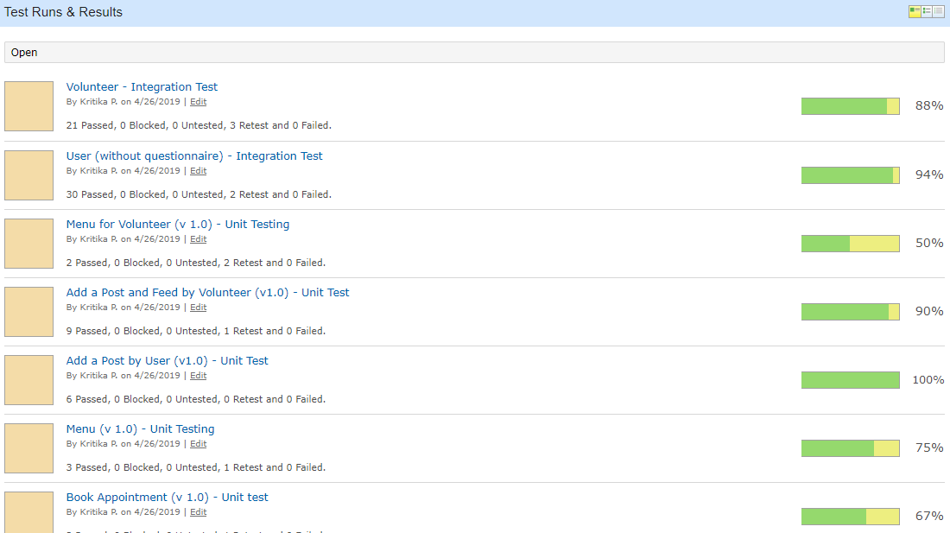
We used TESTRAIL to keep tracks of the test cases.
Test Case Status for Happifier App .

Slide 68
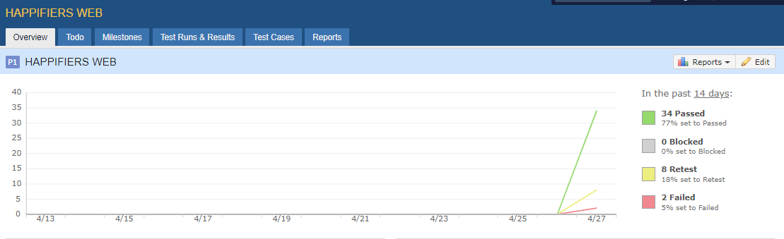
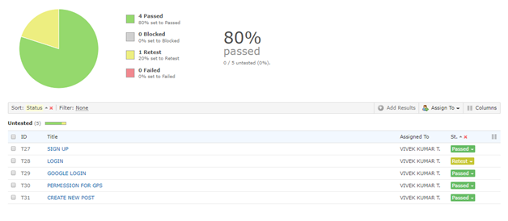
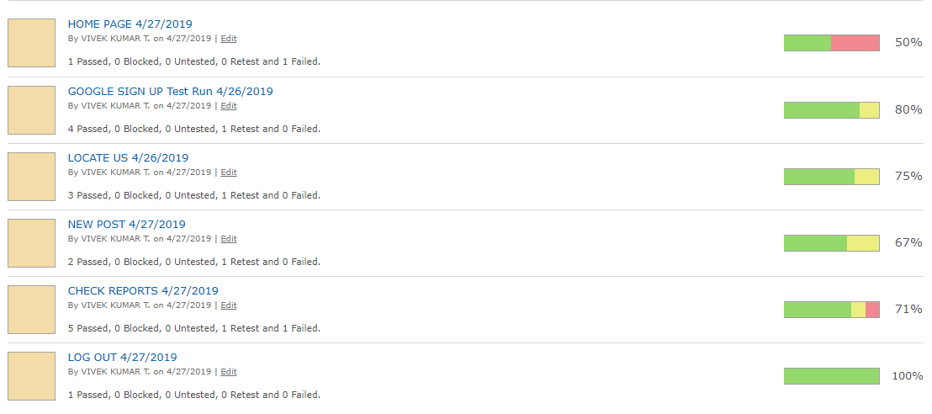
Test Case Status for Happifier Website .

Slide 69
Quality Assurance

Slide 70
What is Quality Assurance?
Software quality assurance consists of a means of monitoring the software engineering processes and methods used to ensure quality. The steps of Quality Assurance are:
Review of requirements
Test planning / writing test cases
Unit testing
Integration testing
System testing
Performance testing
Security testing
Cross-browser testing / cross-platform testing
Updating test cases
Regression testing

Slide 71
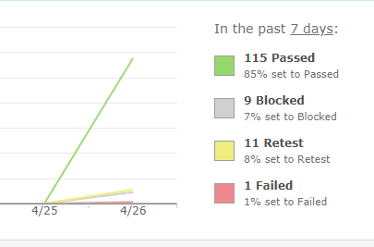
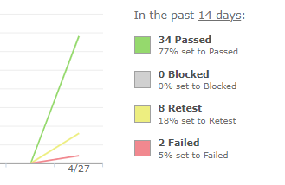
What has been done?
For App
All the required tests were performed, along with the team and the group of testers in order to insure quality of the projectl. Though there were quite a few defects left that need to be improved upon, the parts that have been accepted by us under QA have been tested through and through.
For Website

Slide 72
TRACEABILITY MATRIX

Slide 73
Traceability Matrix (APP)
 | Requirements | R1 | R2 | R3 | R4 | R5 | R6 | R7 | R8 | R9
Test Cases
C1 |  | X
C2 |  |  | X
C3 |  |  |  |  | X
C4 |  |  |  |  | X | X
C5 |  |  |  |  |  |  |  | X | X | X
C6 |  |  |  |  |  | X
C7 |  |  |  |  |  | X
C8 |  |  |  |  | X | X | X

Slide 74
Traceability Matrix (WEBSITE)
 | Requirements | R1 | R2 | R3 | R4 | R5 | R6 | R7 | R8
Test Case
C1 |  | X | X | X
C2 |  |  |  |  |  |  |  | X | X
C3 |  |  |  |  | X | X | X
C4 |  |  |  |  | X | X | X
C5 |  |  |  |  | X | X | X
C6 |  | X | X | X |  |  |  | X | X

Slide 75
Stakeholder Management

Slide 76
STAKEHOLDER MATRIX
Our Team
I
N
F
L
U
E
N
C
E
HIGH
HCL Team
Student Community
Blue Circle
LOW
Mrs Snigdha Biswas
Volunteers
LOW
HIGH
INTEREST

Slide 77
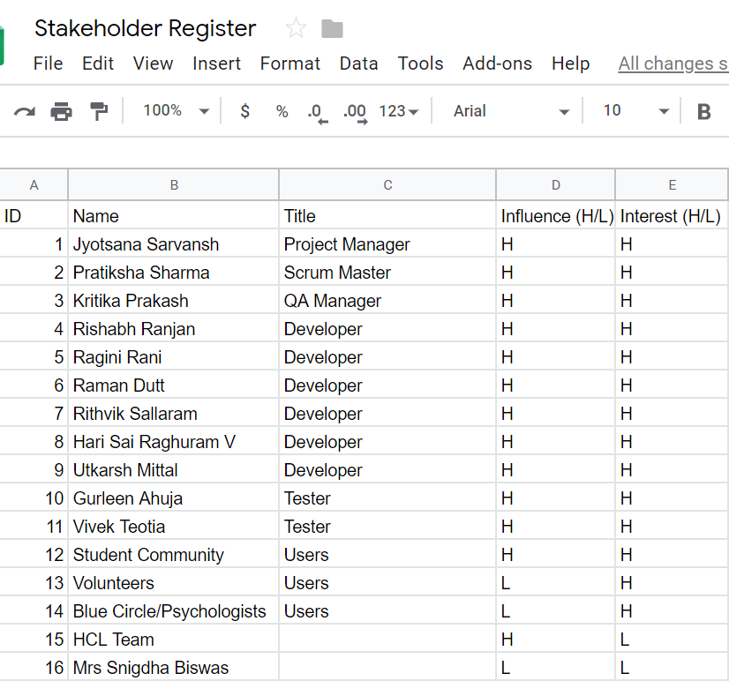
STAKEHOLDER REGISTER

Slide 78
DEFECTS & Future Plans
Notes:
Potential defect: incorrect diagnosis.

Slide 79

Defects
Appointments can be booked on previous dates
On website, error shown in login page is also shown on the signup page and vice versa.
No Email verification.
Profile picture of user and volunteer not shown on app. Name of volunteer not shown on app.
To get the current location on app, two click are required on the locate us tab.
Post by volunteer shown as post by “NULL” on the app.
Questions are auto selected in app.
Notes:
Volunteers for the product will be provided by University. Thus, we are dependent on them to provide us with volunteers, which is an internal resource for our product
We can’t control the quality/skill of the volunteers, as they are being provided by the univ. and hence this goes outside our purview. However, in future we plan on providing some basic training to all volunteers on our platform, so that we are assured of a minimum standard of our volunteers.
Though we have volunteers specializing in specific fields, it may not always be possible that the volunteer/specialization field that a student seeks is available. Thus, it may not always be possible to require immediate assistance.

Slide 80

Future plans
Training module for Volunteers
Platform for Professionals to advertise themselves
Notes:
Training module for volunteers: as mentioned in our drawback, we plan to provide a basic training to them so that we are assured of their minimum standard. This may result in better help being provided to the students
Platform for professionals To advertise themselves: in the future, we want our platform to be used by professionals to advertise themselves, as part of our business model
Inclusion of self-help methods: we aim to include some therapy to help students who don’t want to seek external help.

Slide 81
The Team

Slide 82

Roles
Project Manager: Jyotsana
Scrum Master: Pratiksha
Dev. Team: Rishabh, Ragini, Utkarsh, Rithvik, Raghuram, Raman
Quality Assurance Manager: Kritika
Testers: Gurleen, Vivek

Slide 83
Thank You!
Questions? Suggestions?

